Slide 1
CSE 163
Numpy
Dylan Jergens

Slide 2
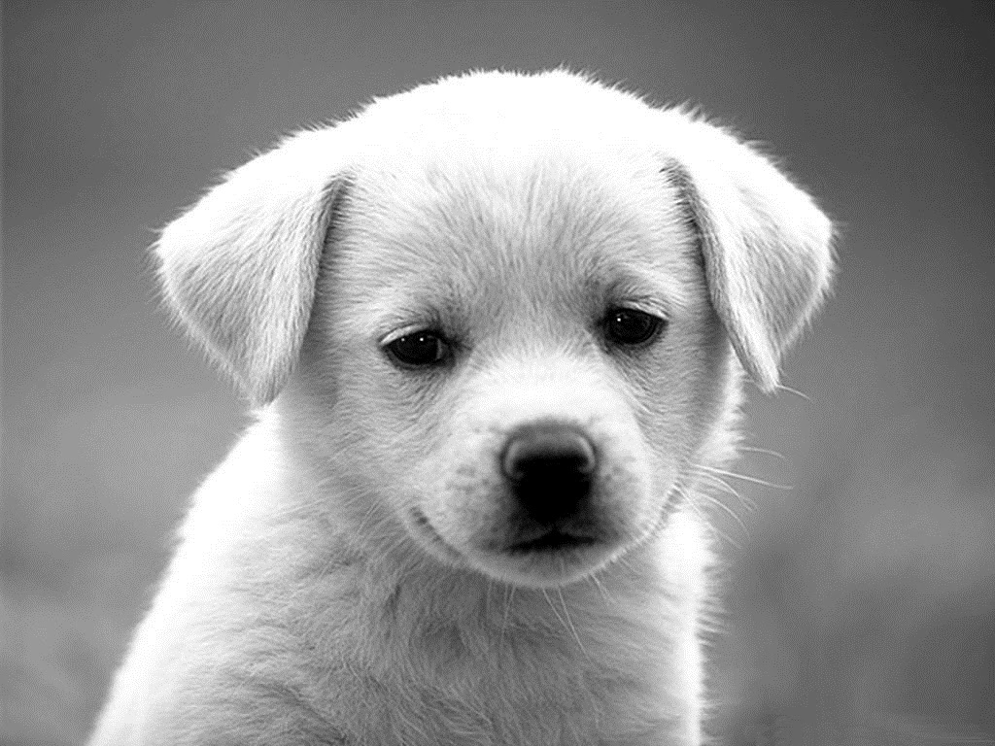
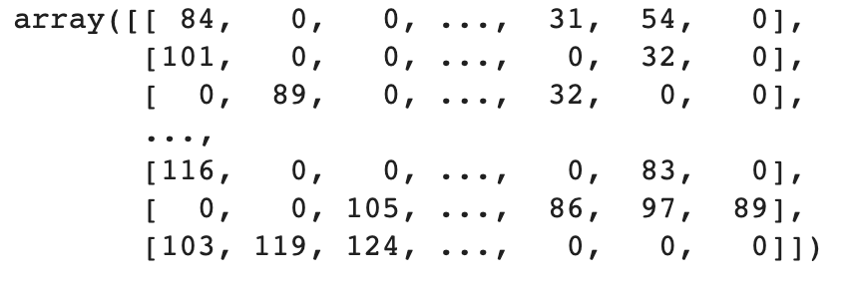

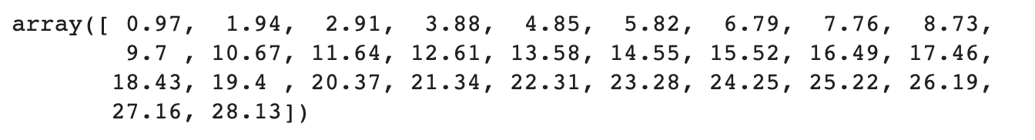
Images and
Sound

Slide 3
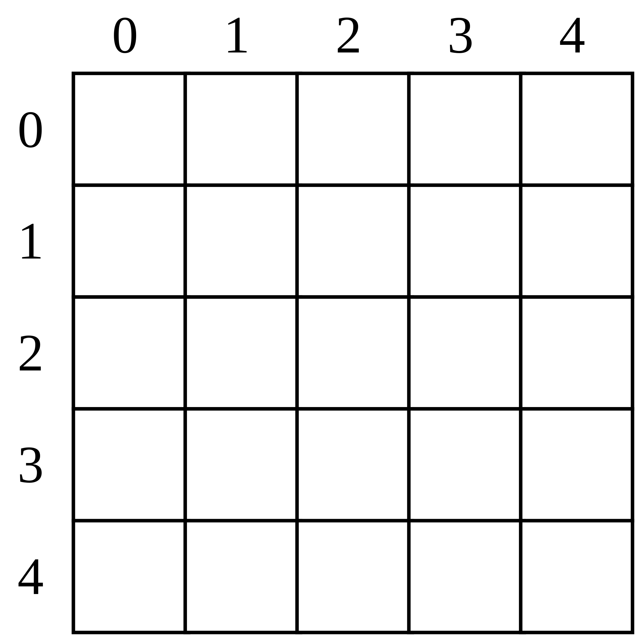
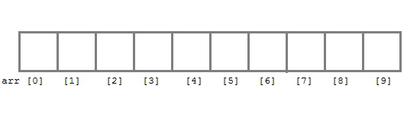
Vectors &
Matrices
Vectors/Arrays
One-dimensional arrays.
Look and behave very similar to Python lists.
Matrices
Multi dimensional arrays.
You can think of them as a number of vectors stacked on top of each other.

Slide 4
Shape
Numpy arrays have a notion of shape.
Shape is defined as a tuple (M, N), where M is the number of rows and N is the number of columns.
Shape: (1, 10)
Shape: (5, 5)

Slide 5
Reshaping
Sometimes when we are doing linear algebra, shape is important in the calculations.
Numpy provides a function called reshape that allows us to change the shape of an array without change the data inside.
v = np.array([1, 2, 3, 4, 5, 6, 7, 8, 9])
v = v.reshape((3, 3)) # (3 rows, 3 columns)
The resulting array:
array([[1, 2, 3],
[4, 5, 6],
[7, 8, 9]])

Slide 6
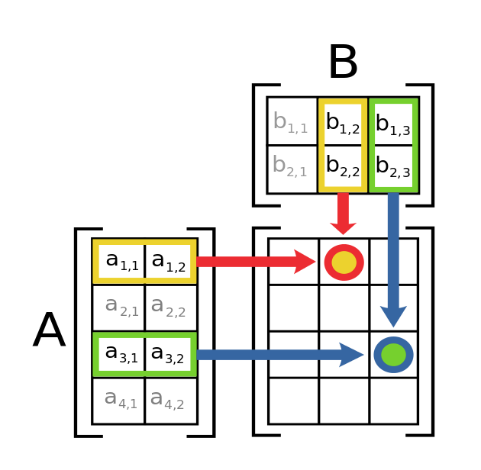
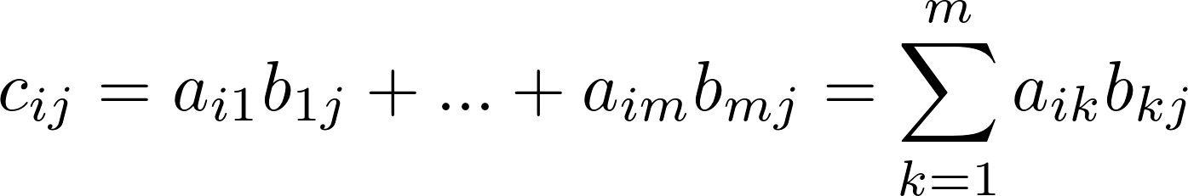
Multiplication
Numpy also allows us to multiply matrices. This can be super helpful when doing linear algebra calculations.
Matrix A has shape (4, 2)
Matrix B has shape (2, 3)
The result of the multiplication is a new matrix C, with shape (4, 2), where

Slide 7
Shape Matters
The result of A x B is a new matrix with shape (4, 3)
When multiplying two matrices, the shape of the two matrices matters!
The inner dimensions must match, and a matrix with the outer dimensions is produced.

Slide 8
Element-wise
Operations
Numpy provides built-in functionality to perform arithmetic operations on vectors and matrices.
v = np.array([1, 2, 3])
v + 2 # [3, 4, 5]
v - 1 # [0, 1, 2]
v * 3 # [3, 6, 9]
v / 2 # [0.5, 1., 1.5]
v // 2 # [0, 1, 1]

Slide 9
Broadcasting
A set of rules for applying operations to arrays of different sizes.
The Rules of Broadcasting
If the two arrays differ in their number of dimensions, the shape of the one with fewer dimensions is padded on it’s left side.
If the shape of two arrays does not match on any dimension, the array with shape equal to 1 in that dimension is stretched to match the other shape.
If in any dimension the sizes disagree and neither is equal to 1, an error is raised.
Notes:
In this tree we can treat left on 1 to correspond to left and the right corresponds to the right of that boundary.
If we look at 3,

Slide 10
Example 1
M.shape = (2, 3)
v.shape = (3,)
By rule 1, we see that v has fewer dimensions so we pad it on the left with ones.
M.shape = (2, 3)
v.shape = (1, 3)
By rule 2, we see that the first dimension disagrees, so we stretch the dimensions to match.
M.shape = (2, 3)
v.shape = (2, 3)
v: [[0, 1, 2],
[0, 1, 2]]

Slide 11
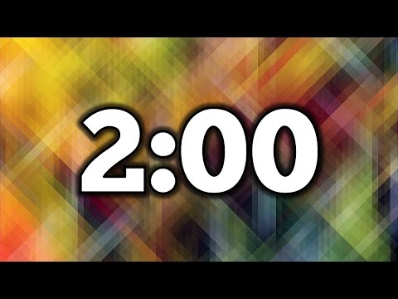
1.5 minutes
np.arange(3).reshape((3, 1)) + np.arange(3)
The Rules of Broadcasting
If the two arrays differ in their number of dimensions, the shape of the one with fewer dimensions is padded on it’s left side.
If the shape of two arrays does not match on any dimension, the array with shape equal to 1 in that dimension is stretched to match the other shape.
If in any dimension the sizes disagree and neither is equal to 1, an error is raised.

Slide 12
2 minutes
np.arange(3).reshape((3, 1)) + np.arange(3)
The Rules of Broadcasting
If the two arrays differ in their number of dimensions, the shape of the one with fewer dimensions is padded on it’s left side.
If the shape of two arrays does not match on any dimension, the array with shape equal to 1 in that dimension is stretched to match the other shape.
If in any dimension the sizes disagree and neither is equal to 1, an error is raised.

Slide 13
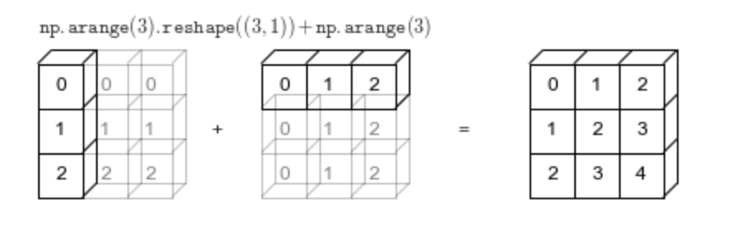
What
Happened?
a.shape = (3, 1)
b.shape = (3,)
a.shape = (3, 1)
b.shape = (1, 3)
a.shape = (3, 3)
b.shape = (3, 3)

Slide 14
Images as
Matrices
Grey-scale images can be represented as matrices.
Grey-scale: 255
Grey-scale: 0

Slide 15
Image Smoothing
How can we smooth the image?
We can take the average of the surrounding pixels, and update the current pixel.

